Slide 1

“resQSquad”
SIH-1440
TEAM ID: 24ARP12
Presented By:
Ankit Kumar(1VE21CS014)
Ankit Singh(1VE21CS015)
Atul Yadav(1VE21CS024)
Guided By:
Sridevi N
Assistant Professor
Dept. of CSE, SVCE

Slide 2
Problem statement SIH-1440
To develop a Platform under which all rescue agencies are registered and which can display the location of other rescue relief agencies during natural/man-made calamities.

Slide 3
Introduction
We have a technological solution for this which is resQSquad.
Our digital solution consists of creating a centralized platform where all the authenticated users like Rescue Agencies NGOs and other organizations are registered.
They can see each other’s location and can collaborate well during a disaster or any calamity.

Slide 4
OBJECTIVES
To enhance the emergency response capabilities by developing an advanced technological tool that improve the speed and efficiency of disaster response.
To improve disaster preparedness by comprehensive disaster preparedness plans for communities.
To collaborate with relevant stakeholders by bringing the government agencies, NGOs, and other organisation to create a unified approach to disaster response.

Slide 5
OUTCOME
1. Time-critical: The platform emphasizes rapid response and timely delivery of information and aid.
2 Location-based: The system relies on real-time geolocation data to match resources with needs efficiently.
3 Collaborative: resQSquad fosters collaboration among various organizations to collectively address disaster response.
4 Technology-driven: The project leverages mobile technology and digital platforms to enhance efficiency and accessibility.

Slide 6
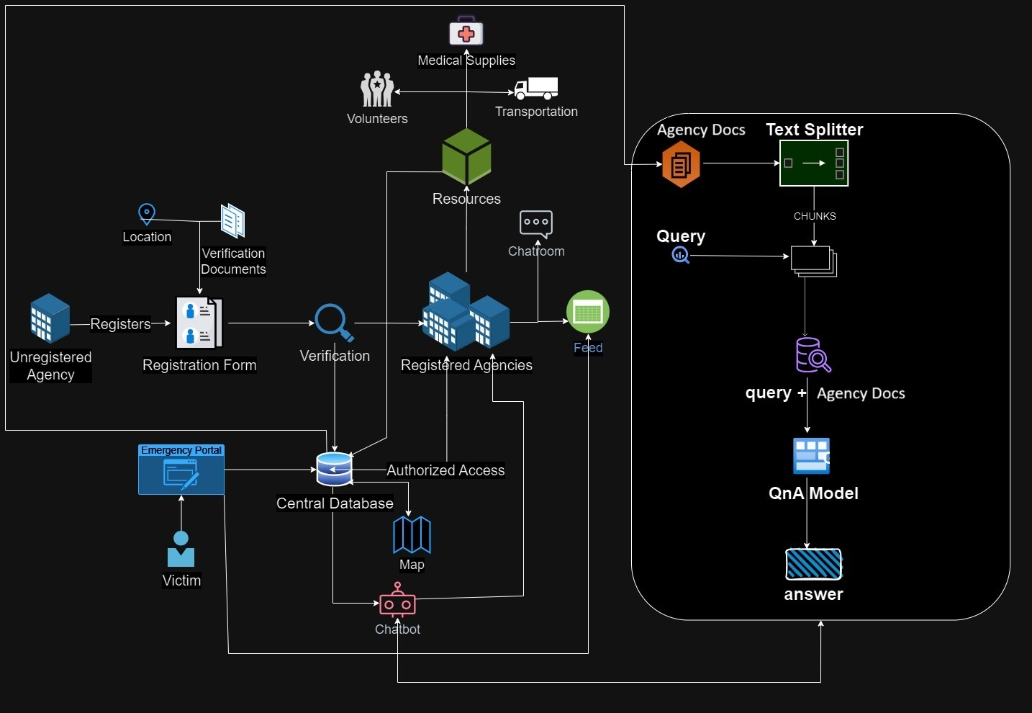
Implementation
Implementation

Slide 7
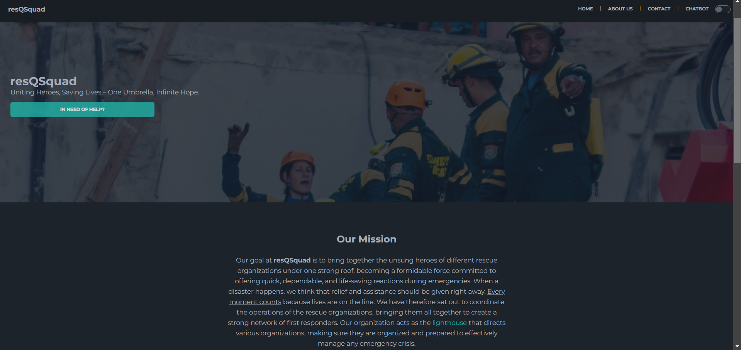

Slide 8
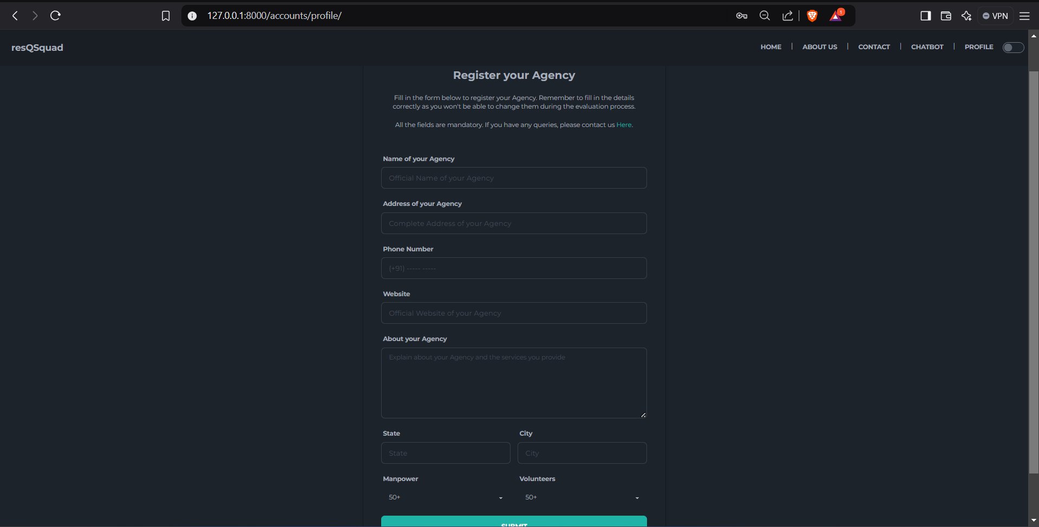

Slide 9
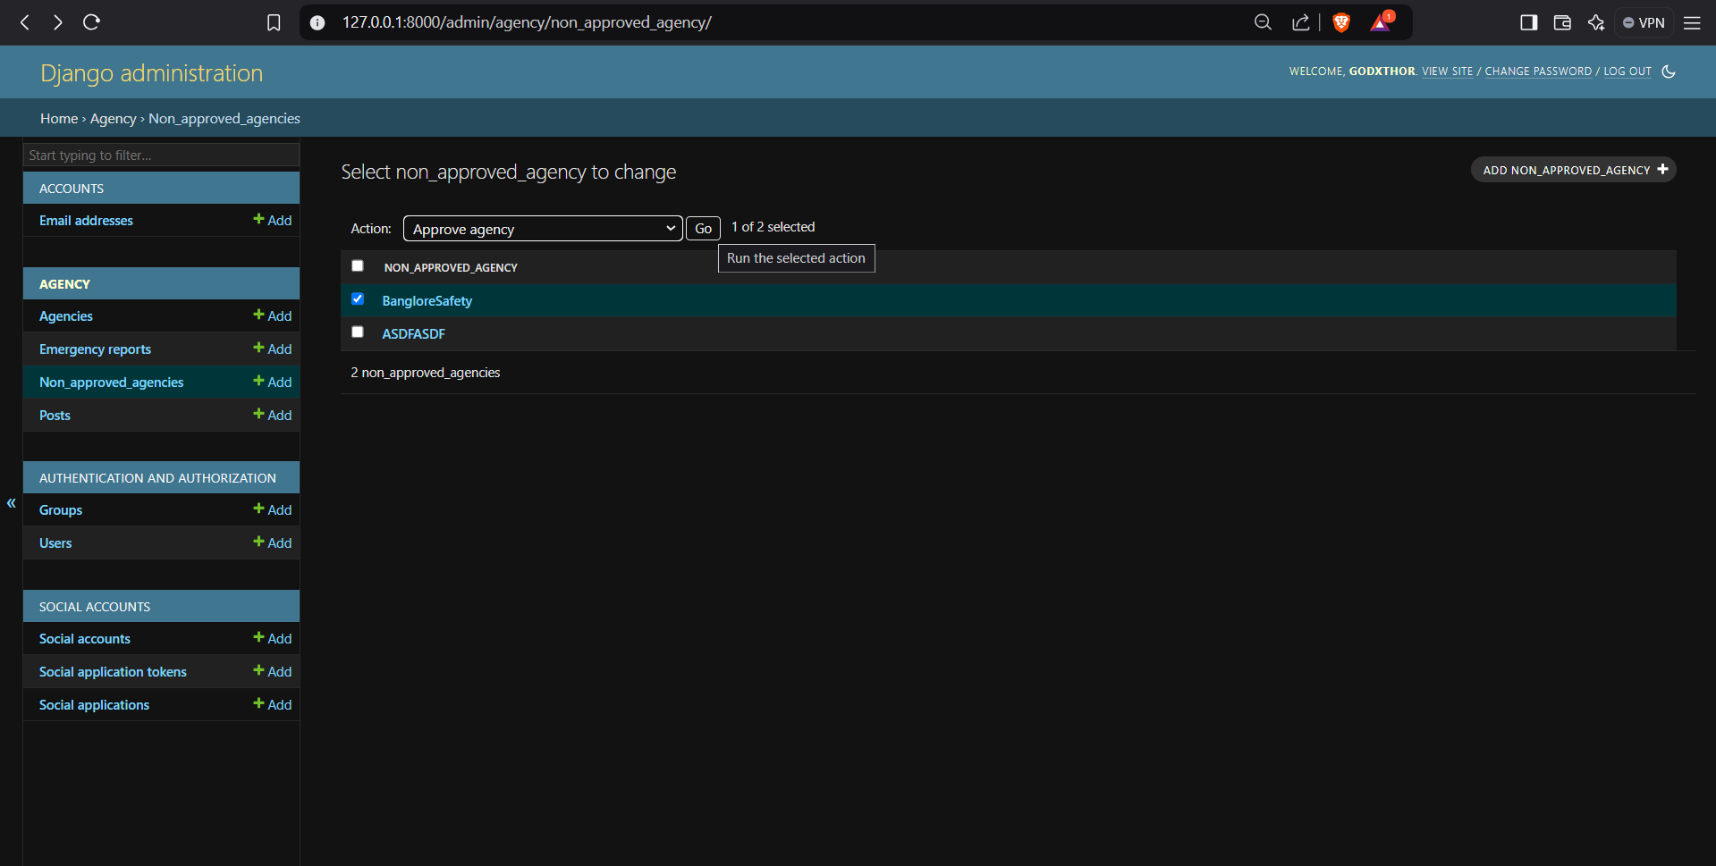

Slide 10
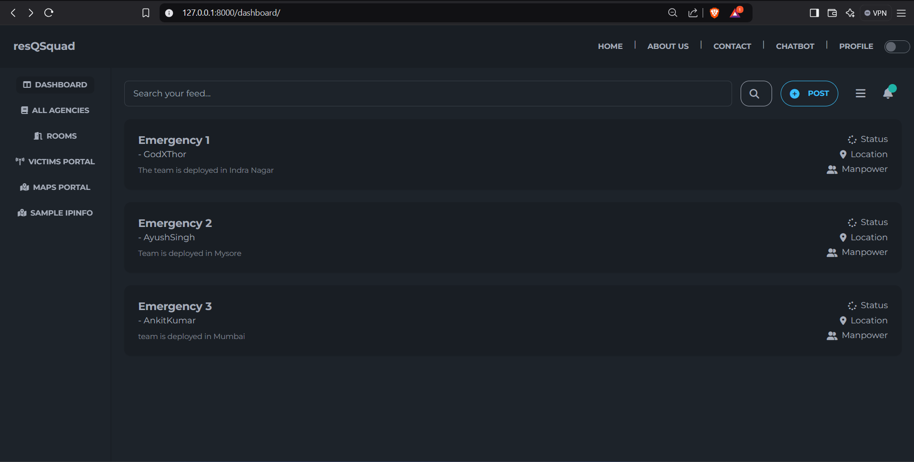

Slide 11
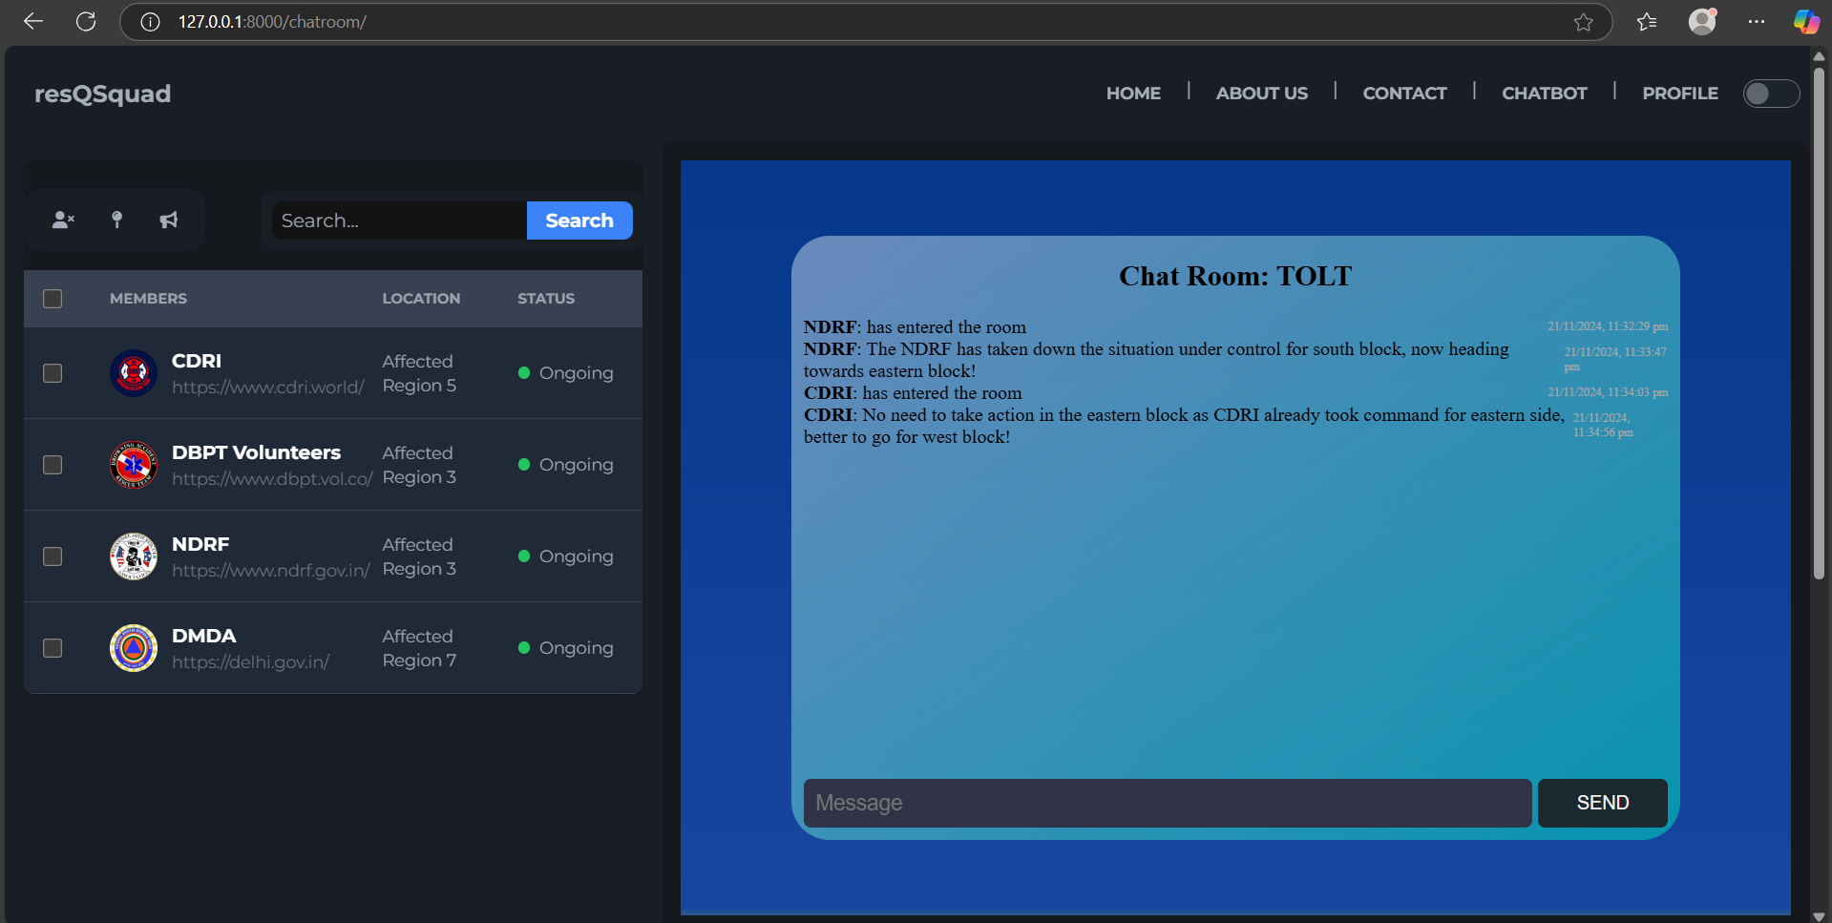

Slide 12
THANK YOU

